Slide 1
Swedish physical activity on prescription, a method on export Kajsa Mickelsson Public Health Agency of Sweden
2020

Slide 2
Photo: Scandinav, Calle Bredberg

Slide 3
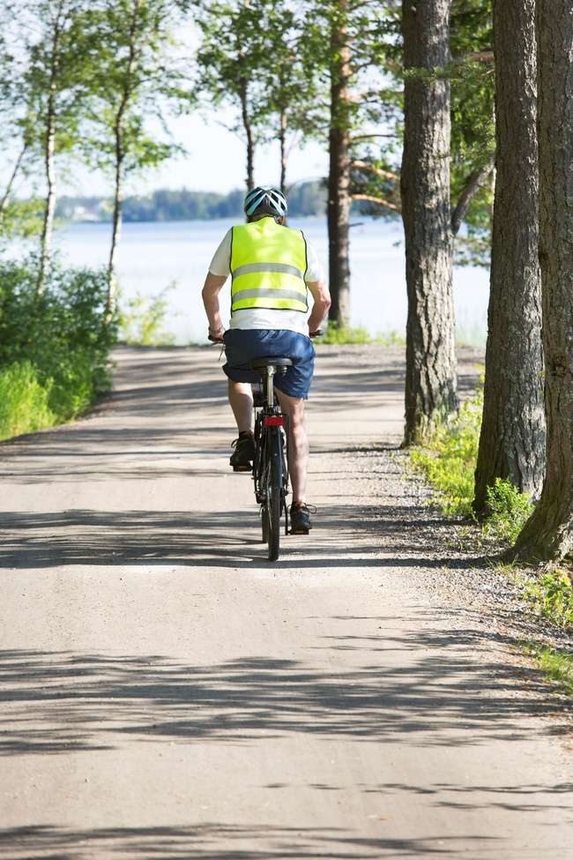
Photo: Scandinav, Jörgen Wiklund

Slide 4
Patient-centred Individualized counselling
Written prescription
FYSS
Evidence based PA recommendation
Follow-up
Supporting environment, community-based network
Swedish Physical activity on prescription
(PAP-S)

Slide 5
Patient-centred Individualized counselling
Written prescription
FYSS
Evidence based PA recommendation
Follow-up
Supporting environment, community-based network
Swedish Physical activity on prescription
(PAP-S)

Slide 6
Photo: Scandinav, Jörgen Wiklund

Slide 7
Patient-centred Individualized counselling
Written prescription
FYSS
Evidence based PA recommendation
Follow-up
Supporting environment, community-based network
Swedish Physical activity on prescription
(PAP-S)

Slide 8
Patient-centred Individualized counselling
Written prescription
FYSS
Evidence based PA recommendation
Follow-up
Supporting environment, community-based network
Swedish Physical activity on prescription
(PAP-S)

Slide 9
Patient-centred Individualized counselling
Written prescription
FYSS
Evidence based PA recommendation
Follow-up
Supporting environment, community-based network
Swedish Physical activity on prescription
(PAP-S)

Slide 10
Patient-centred Individualized counselling
Written prescription
FYSS
Evidence based PA recommendation
Follow-up
Supporting environment, community-based network
Swedish Physical activity on prescription
(PAP-S)

Slide 11
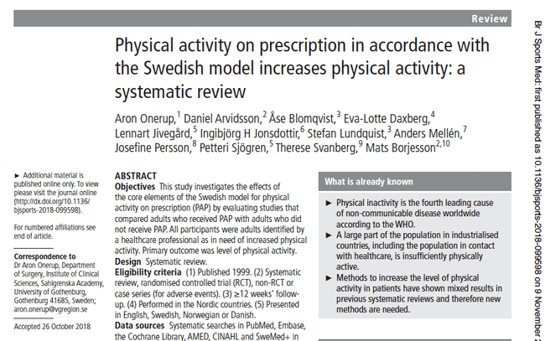
Does PAP work?
The Swedish PAP method increases PA in patients being insufficiently physically active (evidence grade *** )

Slide 12
In Sweden, all licensed health professionals can prescribe physical activity if they have relevant knowledge and are trained to prescribe physical activity to patients.
Prescribing physical activity

Slide 13
The Swedish system that guides the way we work in Sweden
2020 – 02 – 29

Slide 14
The Swedish law states that Health Care has the responsibility for both treatment, and prevention of disease.
Public Health policy - aim to create equal health in the population, and lifestyle behaviours are targeted as being unequal
Sweden take part in Health Promoting Hospitals (HPH-WHO)-network and has national network
Laws & policies

Slide 15
National guidelines
for prevention and treatment of unhealthy lifestyle behaviours
Recommended assessment (questions)
Priorities (risk groups)- elderly, children, pregnant, with disease etc

Slide 17
EUPAP

Slide 18
EUPAP
www.eupap.org

